Slide 1
AAE03a - Autonomous Landing of UAV on Mobile Platform
LEUNG, Cheuk Hei (Hubert)
WAN, Chun Yan (Gorby)
YUEN, Wai Ki (Ricky)
Notes:
traxcStory (current situation, operation, application)
1.UAV auto-landing: goods delivering( amazon, DHL) > how it solves current situation (Aruco code on the platform-increase the accuracy and stability of landing) > how this improvement contribute to cargo delivery {bert}
2.Mobile platform: land on water/boat??? Military usage, rescue? {wcy}
System & sub-system (map-drawing) {ywk}
-link all elements in the project
-physical element ( realsense cam, flight control unit, code, mobile platform (vehicle))
-virtual element (open cv, px 4, ros, linux/ubnatu, realsense viewer)
Progress Report
-hardware (designed frame for fix the camera and the landing gear)
-software ()

Slide 2
Extend Operation Range
Self-landing
Operate without network
Rely on the process power of UAV

Slide 3
Reduce Human Control
Multiple autonomous UAV landings can be monitored at the same time
Reduce the chance of human interference
Increase operation efficiency

Slide 4
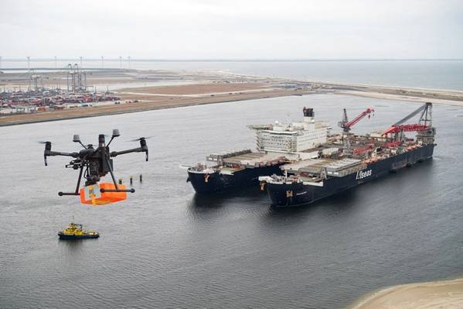
Offshore Landing
Applicable on Oil Platform and Sailing Ship
Counteract the wind speed
Used for small cargo delivery or survey

Slide 5
Landing UAV on Mobile Platform
UAV hover above the target location
Identify the target location using onboard camera
Track the movement and follow its pattern
Send the trajectory to the flight control
Approach and land on the target position
Adjustments if necessary

Slide 6
System Architecture
Onboard Sensor
Searching (YUEN Wai Ki)
Path Planning
(WAN Chun Yan)
Stereo Camera
ArUco Detection
Location Estimation
Proximity Checking
Monitoring
Control (LEUNG Cheuk Hei)
Trajectory
Generation
Laptop (On Ground)
Landing
Onboard Computer

Slide 7
Embedded ArUco (E-ArUco)
Put this aside for now
May go back to it later if other parts are done

Slide 8
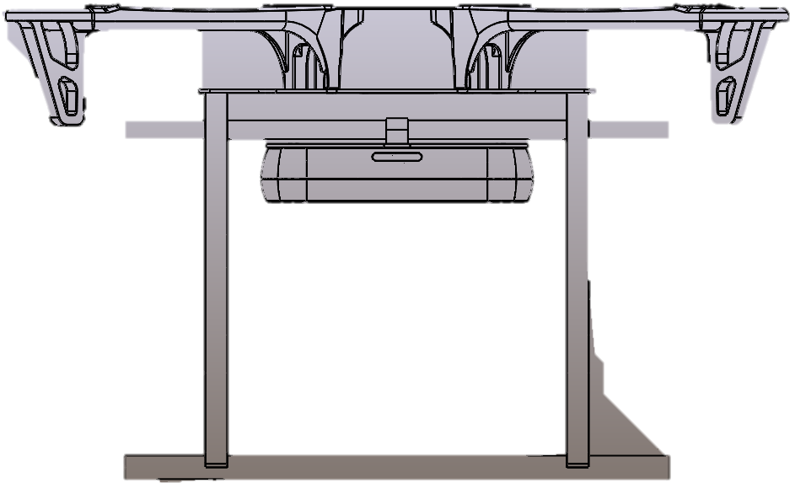


Trajectory Generation
Onboard View
Side View
Notes:
The trajectory is formed by checking the range of error (grey cone) in the camera frame and adjust to allowable range.
The distance for the localization of the ArUeo code is determined by the locus (radius) from the code
Once the code located is fit into the allowable range of error
The UAV may start to descend and approach to the platform
The allowable range of error will reduce during approaching
The localization will be more precise
The range of area fit into the size of the platform
The UAV is allowed to land.

